Slide 1
Multiplex Image Analysis Pipeline
August 2024

Slide 2
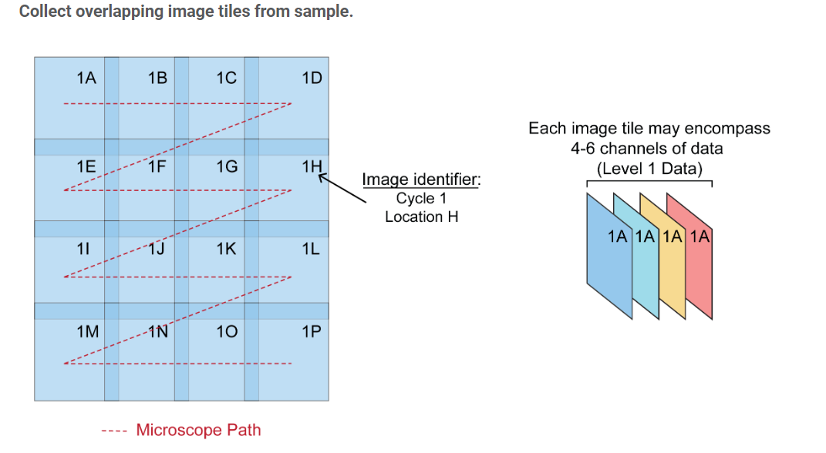
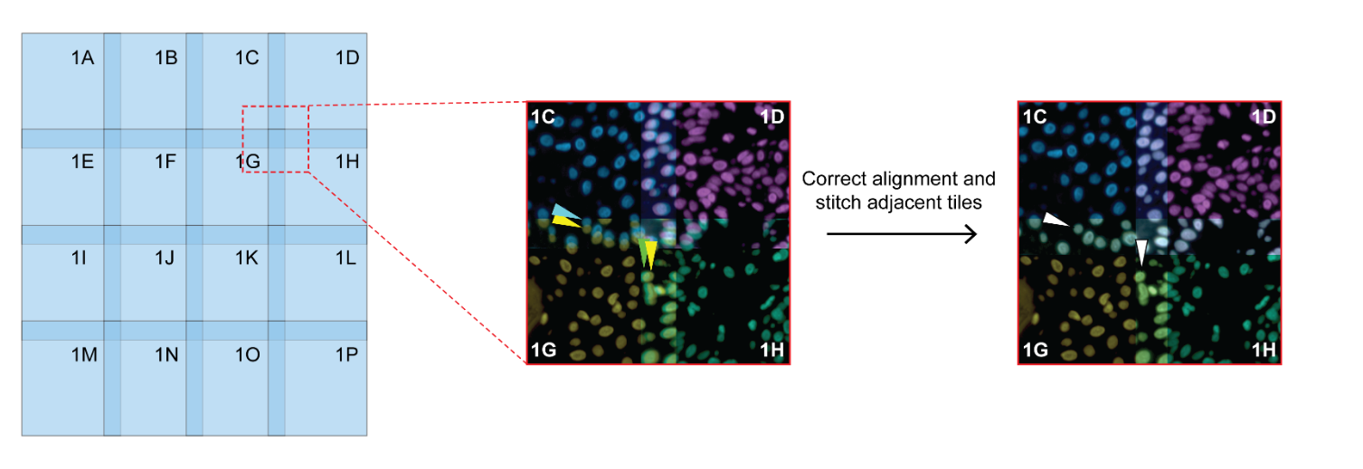
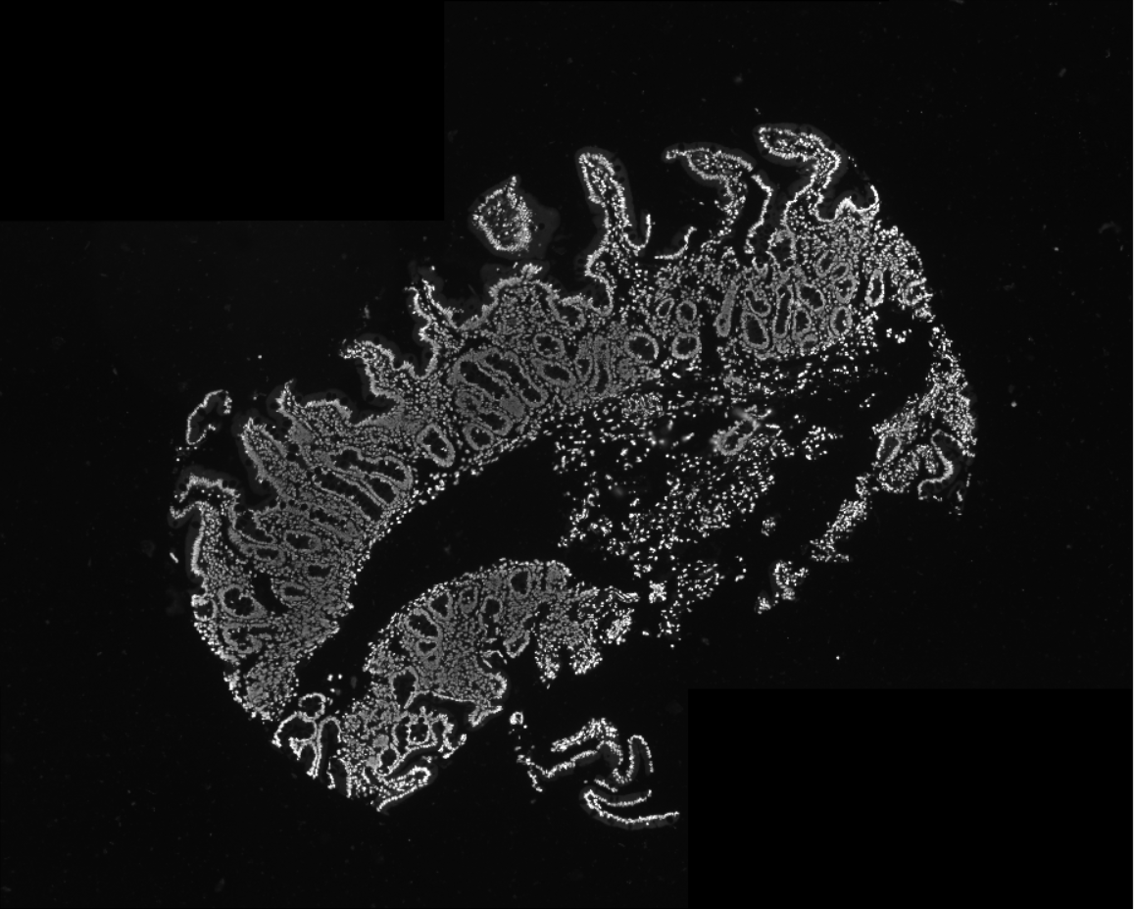
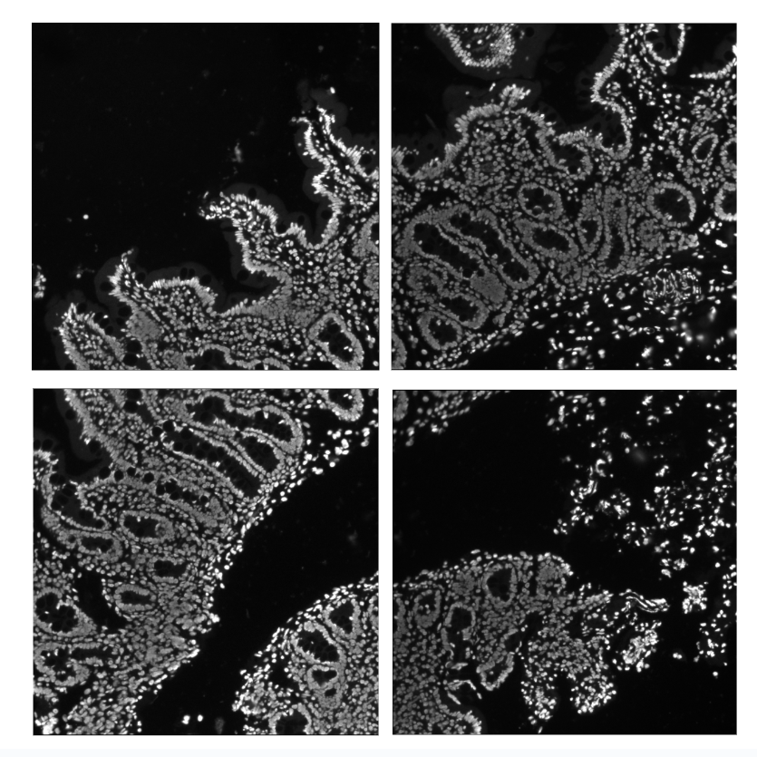
Stitching
-Mcmicro Ashlar
- run through the command line and outputs pyramidal .ome.tif

Slide 3
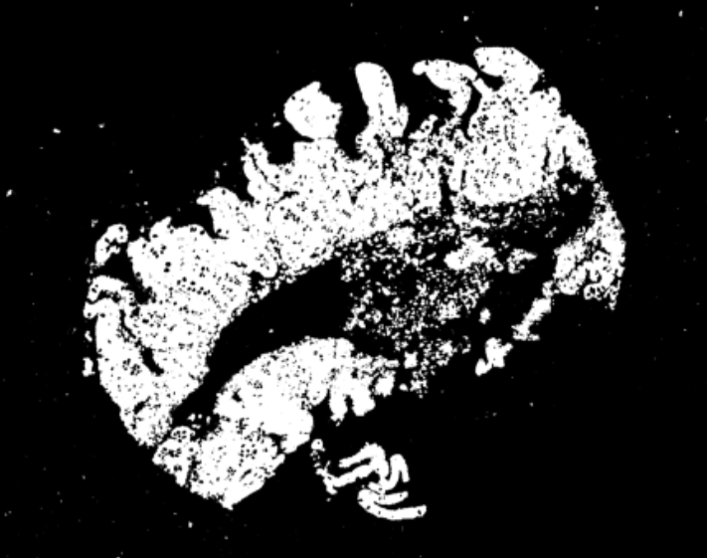
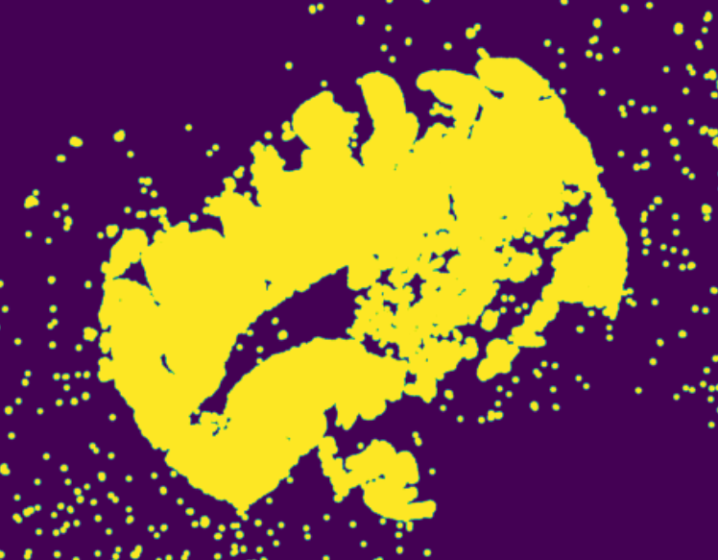
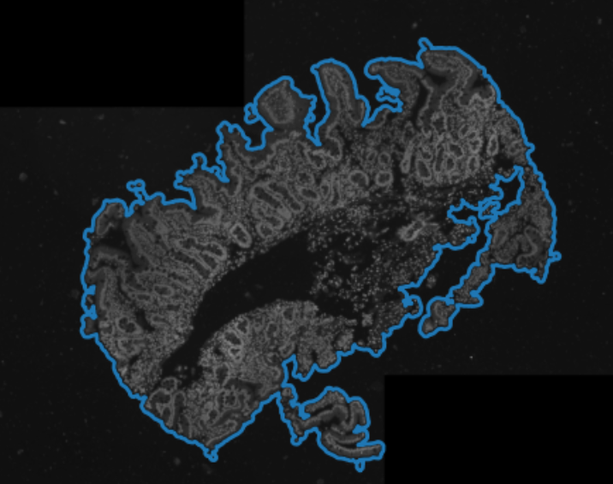
Find Tissue Border
Normalize and add individual stains together
Otsu Threshold
Dilation
Fit contour around largest area

Slide 4
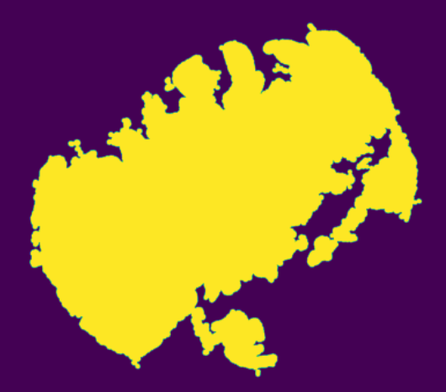
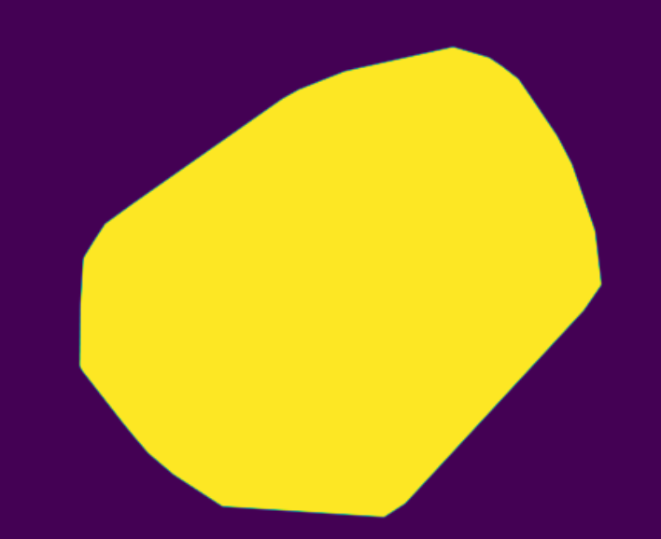
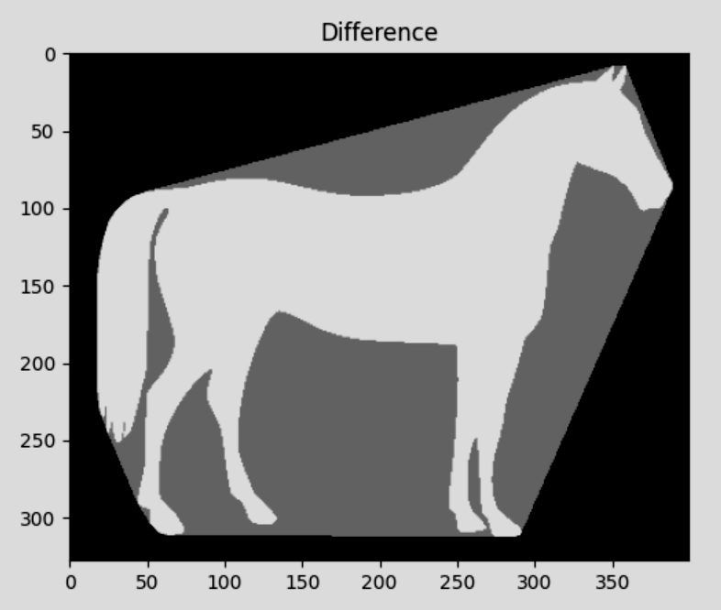
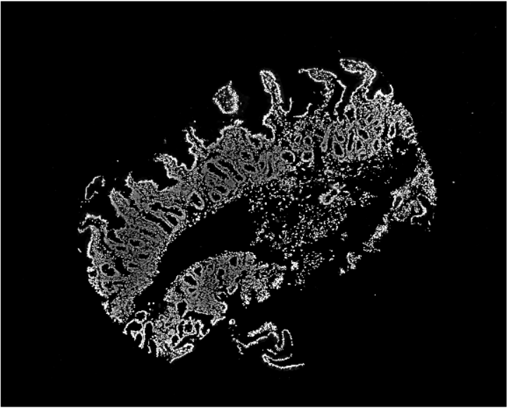
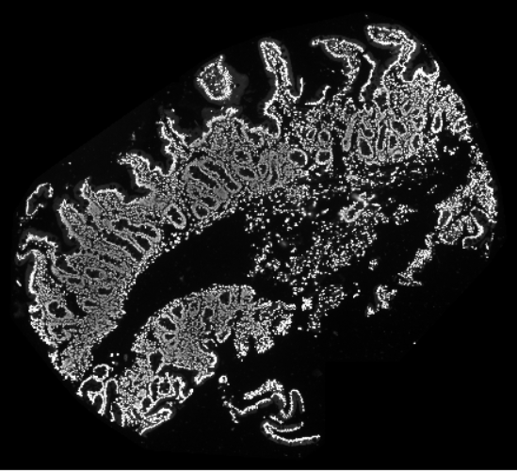
Make Tissue Mask
Fit the smallest convex polygon (convex_hull_image function from scikit-image)
Crop images
Outline mask
Hull mask
Example of convex hull
Notes:
Use hull mask to crop down images

Slide 5
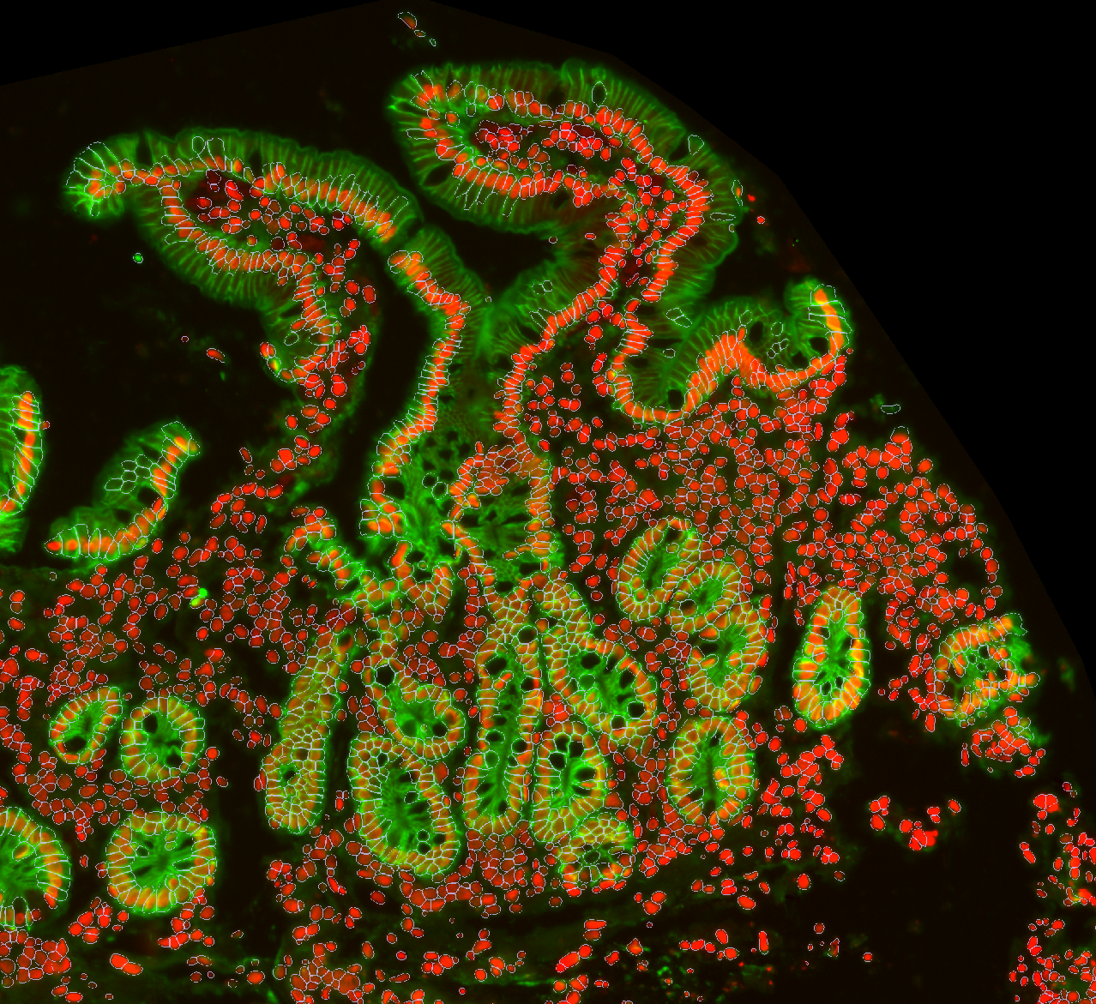
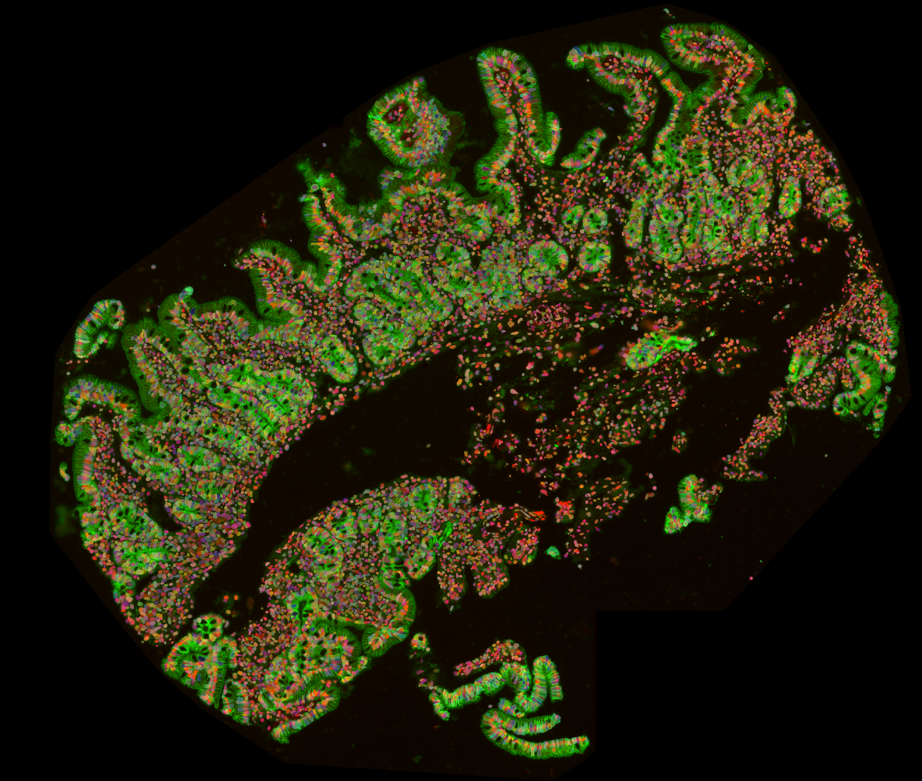
Cellpose
Generalist algorithm for cellular segmentation

Slide 6
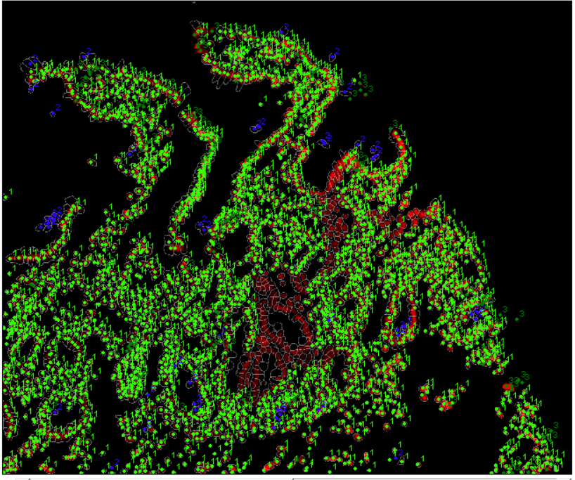
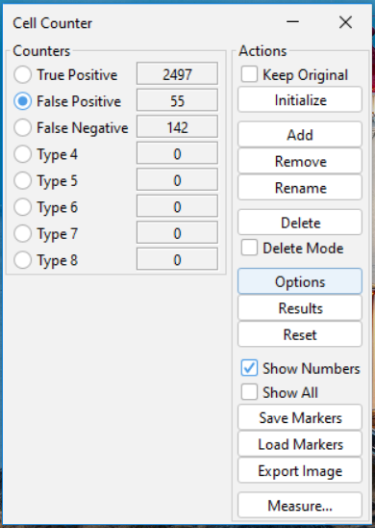
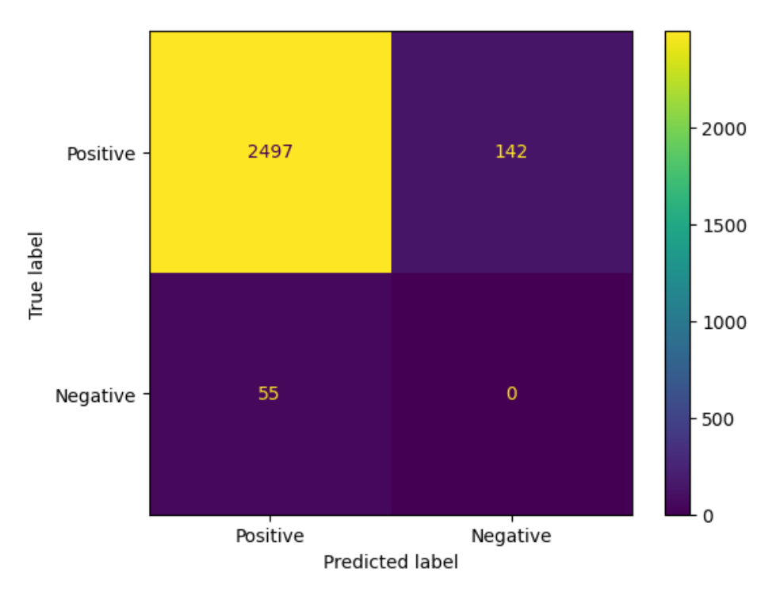
Cellpose Metrics for Nuclei
Precision: 97.8%
Recall: 94.6%
F1-score: 96.3%

Slide 7
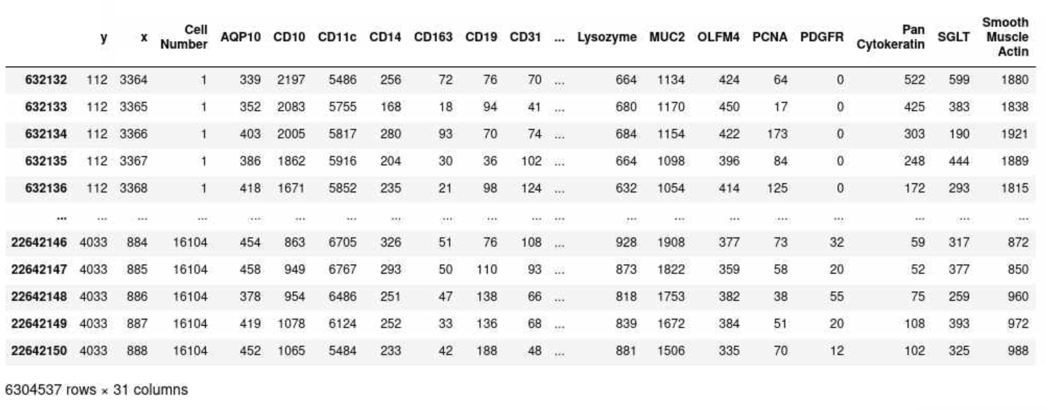
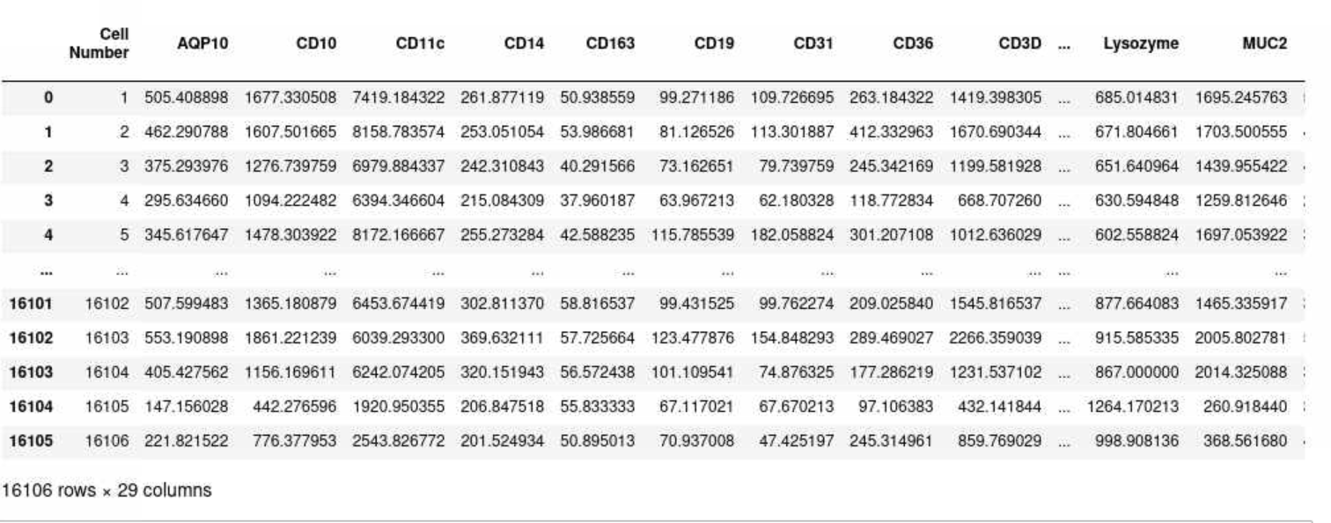
Build Dataframe
Compile segmentation information and image intensity values
Pixels where cell mask is present
Mean intensity value within each cell mask

Slide 8
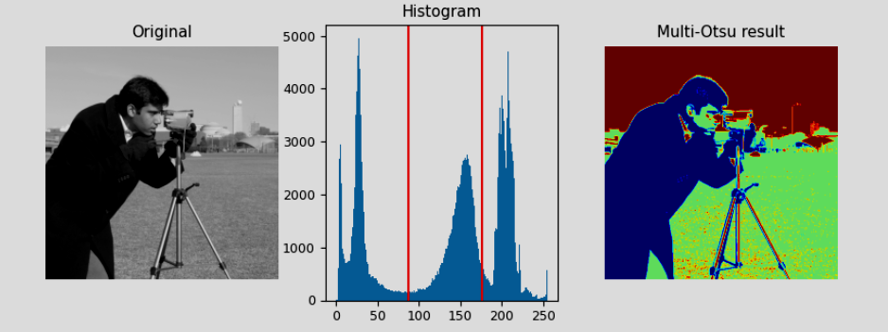
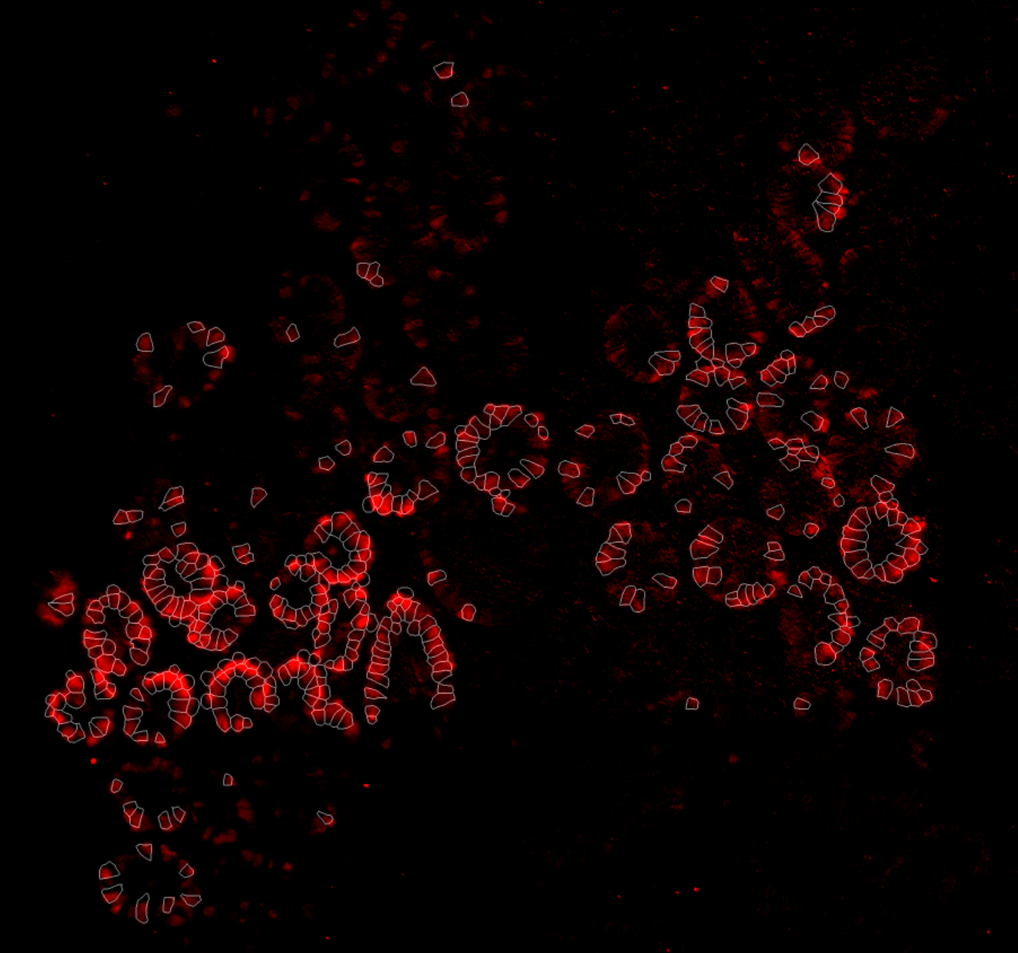
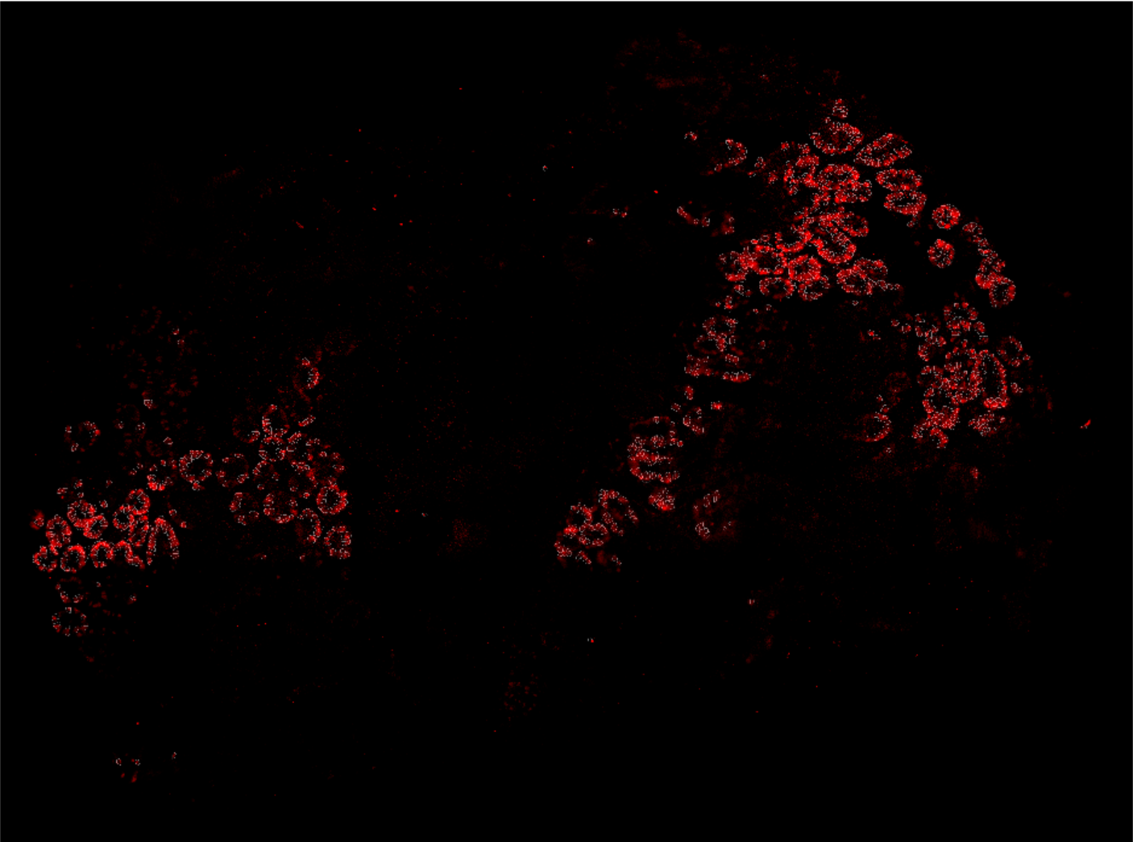
Threshold individual channels
Mutli-Otsu Thresholding: separate pixels into multiple classes based on intensity values
Example of multi-otsu
Thresholding of PCNA

Slide 9
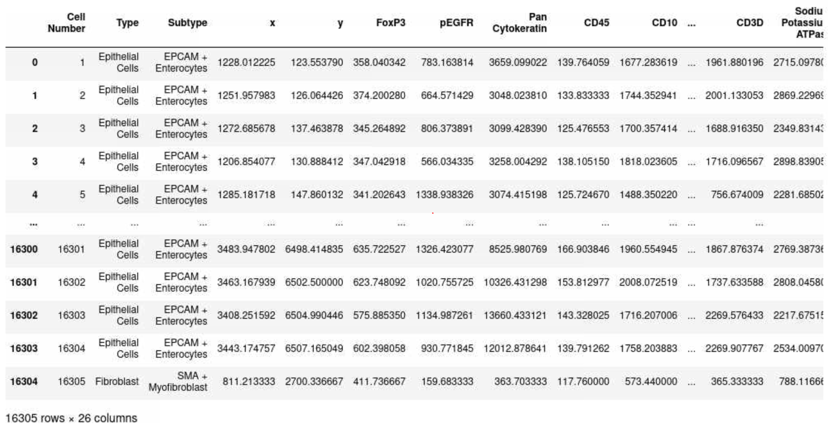
Classification
Classify cell type based on thresholding results
Calculate centroid of cell mask
Cell subtypes:
EPCAM + Enterocytes
MUC2 + Goblet Cells
CD3 + T-Cells
CD31 + Endothelial cell
ChgA + Enteroendocrine Cells
SMA + Myofibroblast
PCNA + Epithelial Cells
pEGFR + Tuft Cells
CD68 + Monocytes
Unspecified

Slide 10
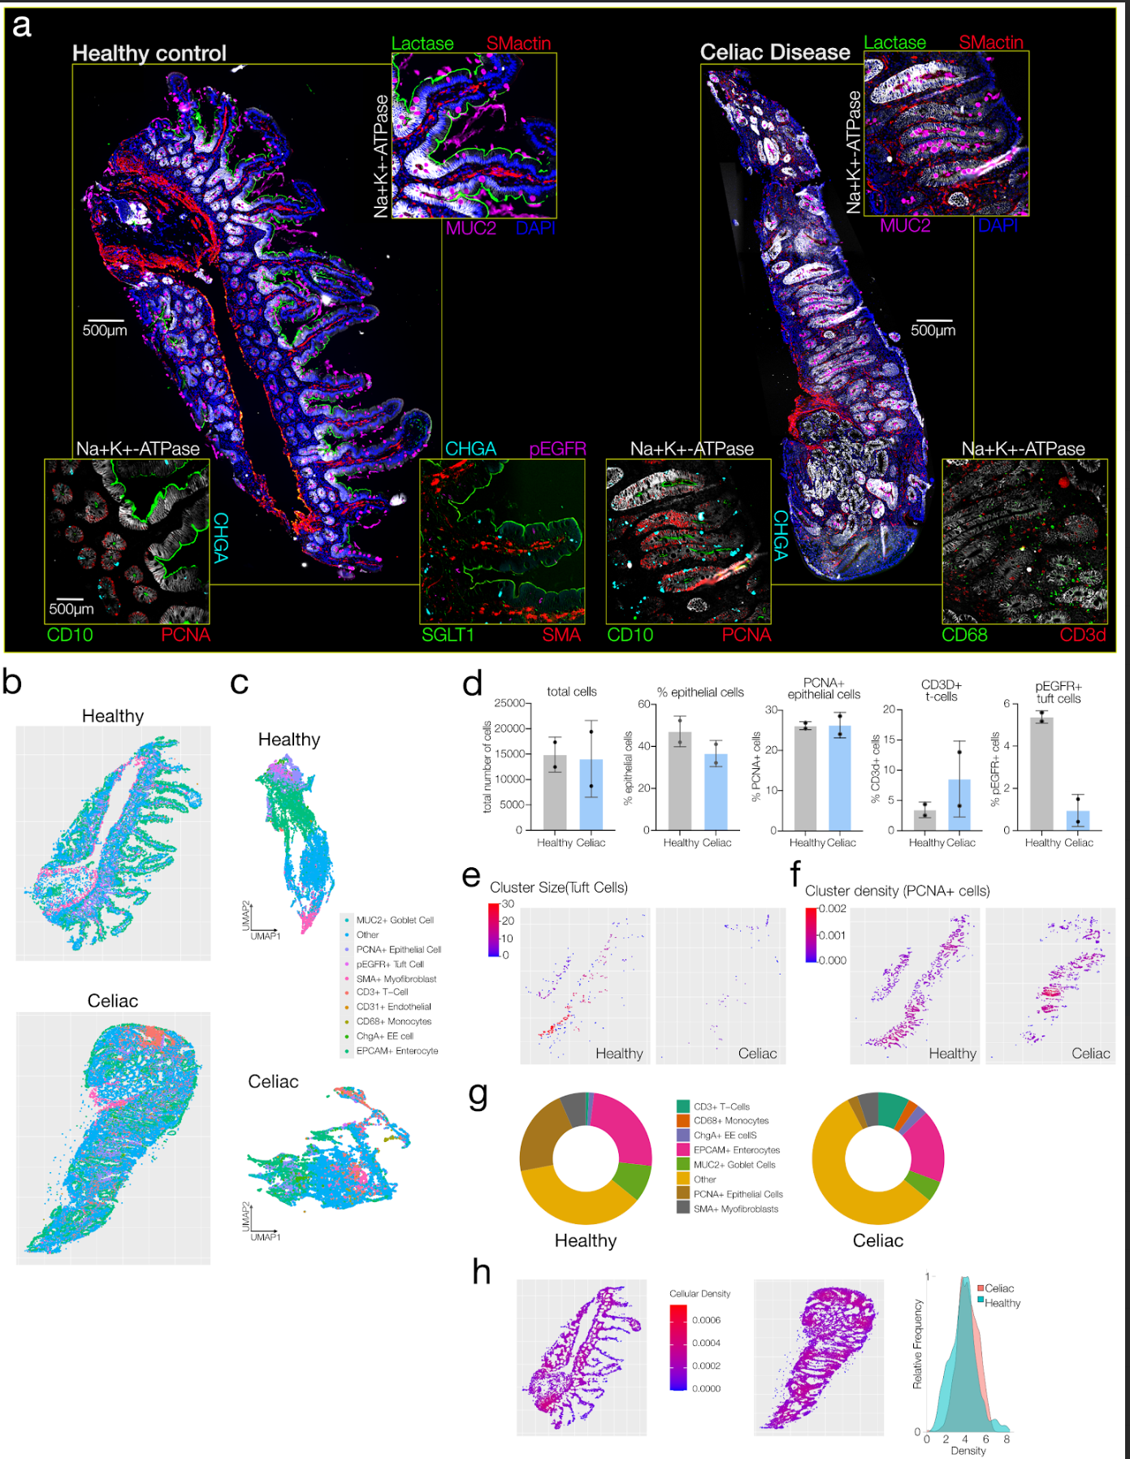
Data visualization
UMAP
Clustering
Nearest Neighbor
Figure 2 - Spectre-plex paper

